Slide 1
Perform Data Wrangling on a Set of Datasets.
Rakesh Devendrasing Pardeshi
Next Hikes IT Solution

Slide 2
Introduction
Objective: Transform raw ride-sharing datasets into clean, structured formats suitable for analysis.
Tools: Utilize Python's Pandas and Matplotlib libraries for data manipulation.
Techniques Applied:
Merging Datasets: Combine multiple datasets to create a unified dataset.
Handling Missing Values: Identify and address gaps in the data to ensure completeness.
Removing Irrelevant Columns: Eliminate unnecessary data to streamline analysis.
Data Type Conversion: Ensure correct data types for accurate analysis.
Outlier Detection: Identify and manage data points that deviate significantly from other observations.
Skewness and Correlation Analysis: Assess data distribution and relationships between variables.
Outcome: Prepare the data for meaningful insights into ride patterns, user behavior, and environmental factors

Slide 3
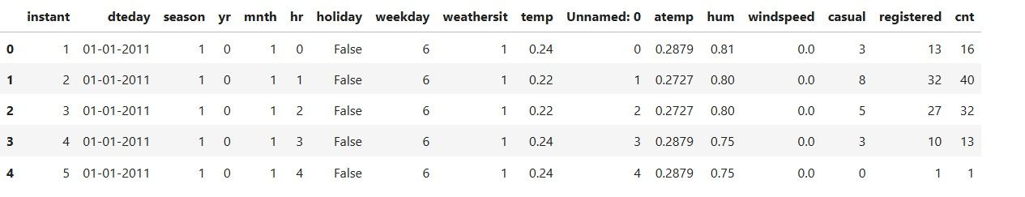
DATASET FIRST AND DATASET SECOND MERGE OUTPUT:

Slide 4
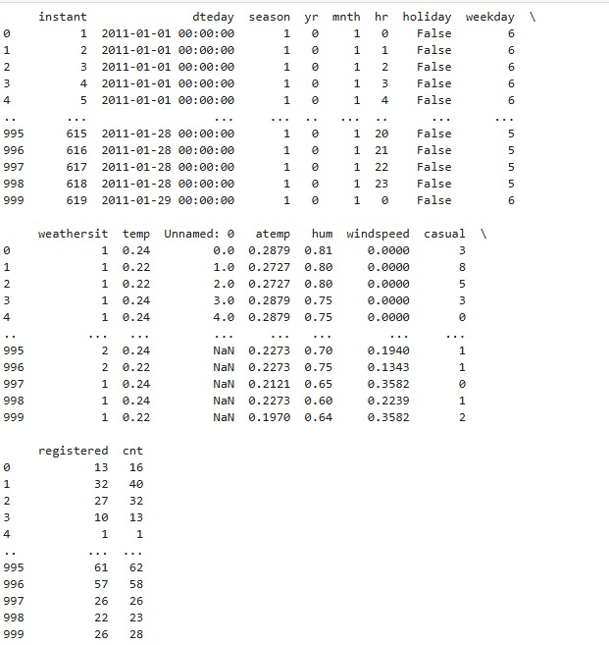
DATASET FIRST & SECOND MERGE DATASET AND DATASET THIRD MERGE OUTPUT:

Slide 5
Any Outlier Present ?
Outliers were detected using the IQR (Interquartile Range) method on numeric columns Step 1: Selected only numeric columns from the dataset for outlier detection. Step 2: Calculated Q1 (25th percentile), Q3 (75th percentile), and IQR (Q3 - Q1). Step 3: Identified outliers as values falling below Q1 - 1.5×IQR or above Q3 + 1.5×IQR. Step 4: Removed rows containing outliers to ensure cleaner and more reliable data. Note: No values were replaced or imputed—only outlier rows were deleted.

Slide 6
Thank You !

